Slide 1
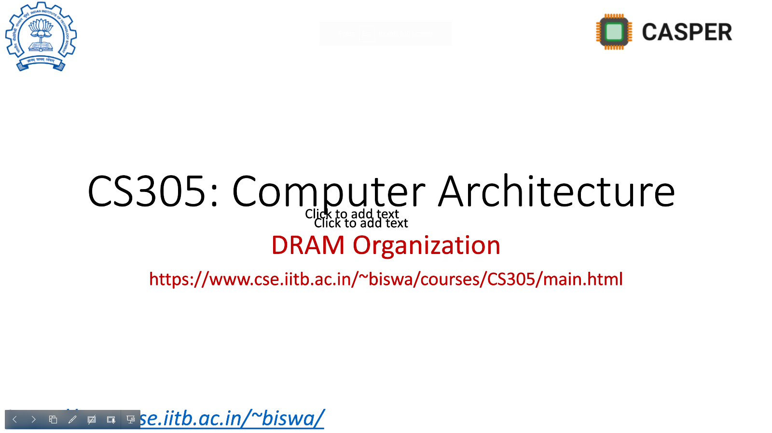
Biannual progress seminar – I (MS by research) Mitigating transient execution attacks with focus on performance-security tradeoff
Sumon Nath (21q050007) guided by Prof. Biswabandan Panda sumon@cse.iitb.ac.in

Slide 2
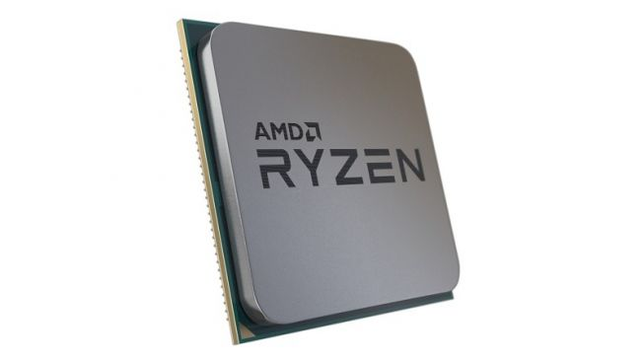
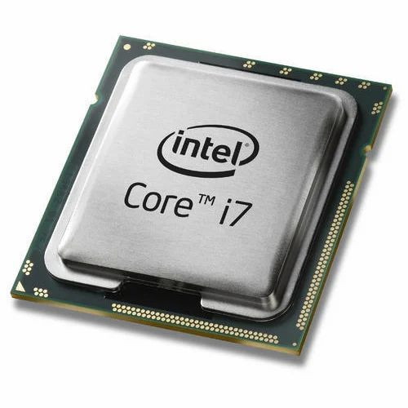
Modern day processors
Out of order
Value predictors
Superscalar
Cache prefetchers
Speculative execution
TLBs
Sophisticated branch predictors
Cache hierarchy

Slide 3
What about security?
If ( x < array1_size )
y = array2[ array1[ x ] ]
Mistrains
branch predictor
Victim code
cache
Invokes victim with out-of-bound x = 19
Secret key = array1[x] = 49
Attacker measures which location of array2 was brought into cache
49
129
array2[49]
Notes:
Spectre/ Spectre Rewind

Slide 4
Spectre[1]
2
1
Attacker
Victim
Set 0
Set 1
Secret
Primes
3
Shared[Secret]
Evicted location == Secret
Cache
[1] Kocher, Paul, Jann Horn, Anders Fogh, Daniel Genkin, Daniel Gruss, Werner Haas, Mike Hamburg et al. "Spectre attacks: Exploiting speculative execution." Communications of the ACM 63, no. 7 (2020): 93-101.

Slide 5
Mitigations proposed & limitations
Preventing speculative execution – lfence instruction
Software fix, high performance overhead
Preventing access to secret data – modifying code
Software fix

Slide 6
Common Idea
2
Attacker
Victim
Set 0
Set 1
Secret
Primes
3
Shared[Secret]
Cache
Problem: Access to speculative data across domain boundaries

Slide 7

MuonTrap [ISCA ‘20]
DRAM
Stores all speculative data
Wiped on context switch
Non-inclusive/non-exclusive
Instruction cache, TLBs
LLC
L2
L1D
Filter cache
L0
Does this work always?
CPU

Slide 8
Attack scenario
*execution: out-of-order
… = *X;
… = *Y;
non-spec instrs;
if(i < N) { //mispredict
secret = A[i];
k = B[secret * 64];
spec dependent instrs(k); }
0 or 1
&B[0] cached
&B[64] not cached

Slide 9
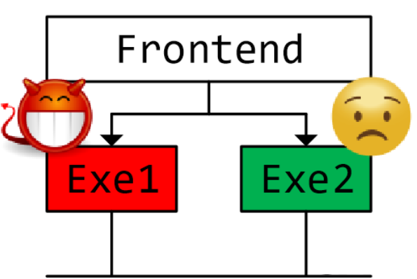
Execution unit contention
non-spec instrs;
if(i < N) { //mispredict
secret = A[i];
k = B[secret * 64];
spec dependent instrs(k); }
CDB

Slide 10
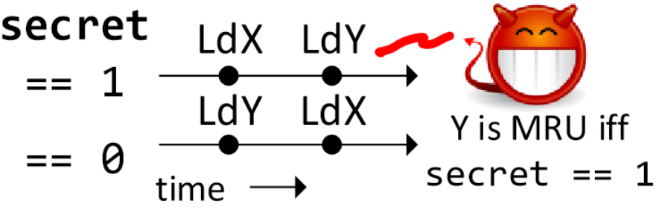
Attack scenario
non-spec instrs;
if(i < N) { //mispredict
secret = A[i];
k = B[secret * 64];
spec dependent instrs(k); }
Speculative Interference^{[ASPLOS]}

Slide 11

Does MuonTrap work?
non-spec instrs;
if(i < N) { //mispredict
secret = A[i];
k = B[secret * 64];
spec dependent instrs(k); }
Does not take care of backwards-in-time channels
No!

Slide 12
Till now…
Spectre
MuonTrap
Speculative Interference
Why MuonTrap does not work?
Next: GhostMinion

Slide 13
What can be done?
non-spec instrs;
if(i < N) { //mispredict
secret = A[i];
k = B[secret * 64];
spec dependent instrs(k); }
We need to restrict backward-in-time channels
How?

Slide 14
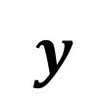
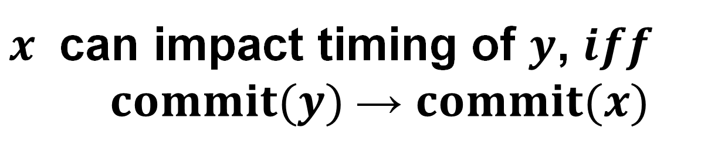

Strictness ordering
$x$ can impact timing of $y$, $iff$
$commit(y)$→ $commit(x)$
$$y$$
non-spec instrs;
if(i < N) {
secret = A[i];
k = B[secret * 64];
spec dependent instrs(k); }
commits
doesn’t
commit
$$x$$

Slide 15


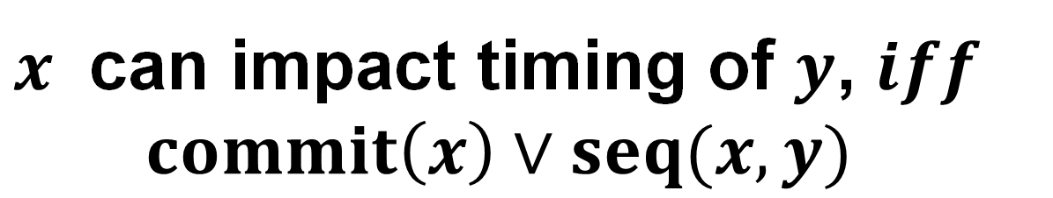
Temporal ordering
*strictness ordering hard to implement
$x$ can impact timing of $y$, $iff$
$commit\left(x\right)∨seq(x, y)$
Does it ensure strictness ordering?
yes! $seq\left(x, y\right)\text{→ }commit(y) \text{→ }commit(x)$

Slide 16
Implementation
GhostMinion[MICRO ‘21] - cache system
Techniques:
TimeGuarding
Free-slotting
LeapFrogging
*Applied to other microarchitecture structures

Slide 17
GhostMinion
Same as MuonTrap
Accessed in parallel to L1D
DRAM
LLC
L2
L1D
GM
CPU

Slide 18
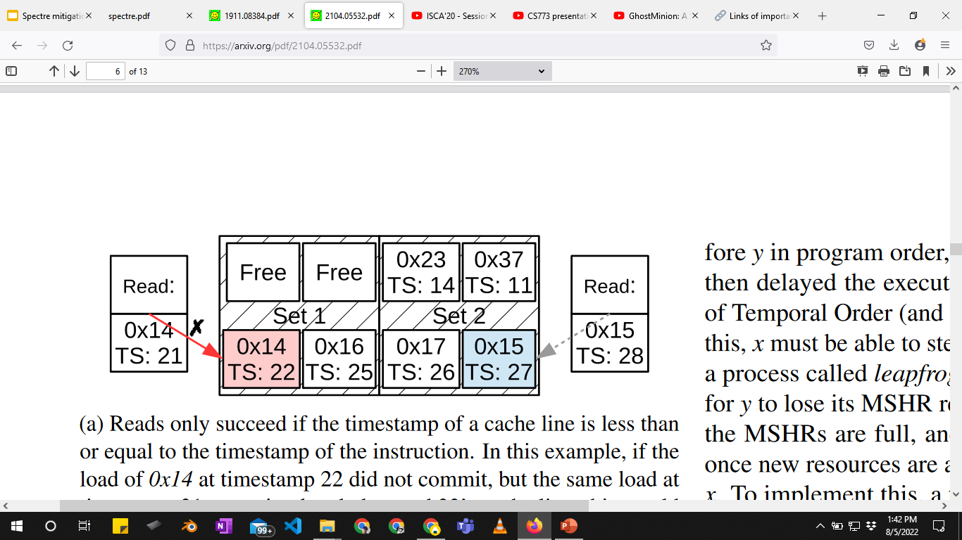
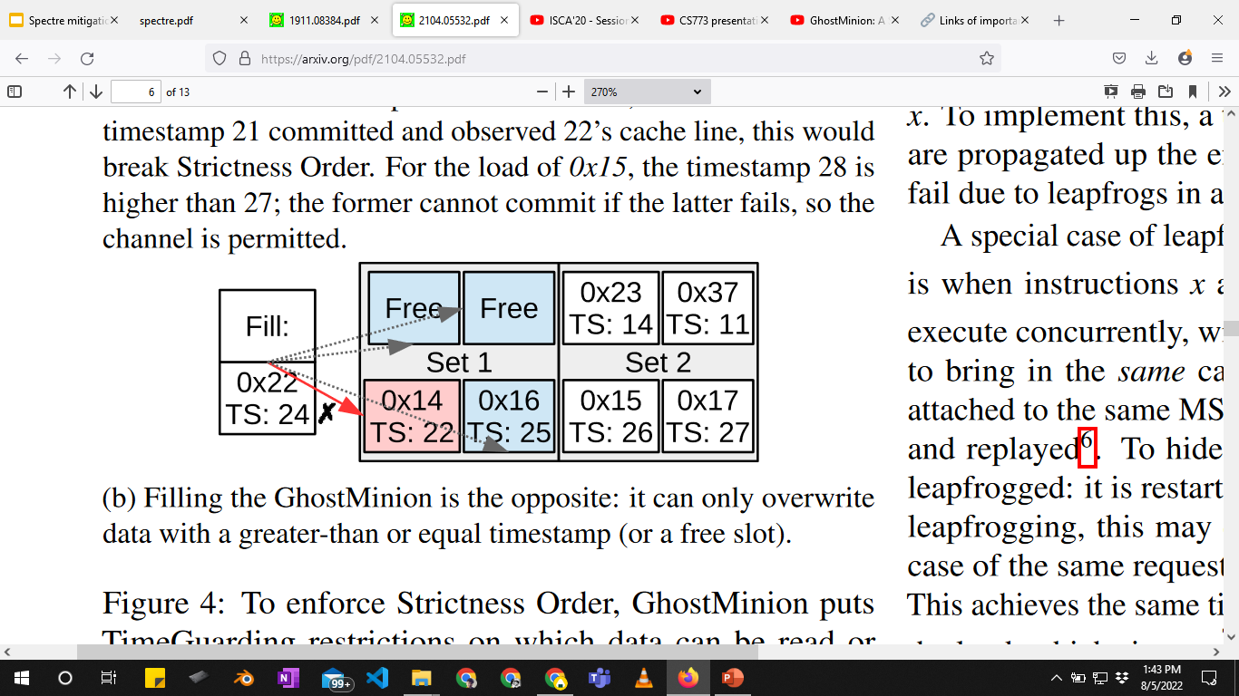
TimeGuarding
Ensures temporal ordering
Read
Fill

Slide 19
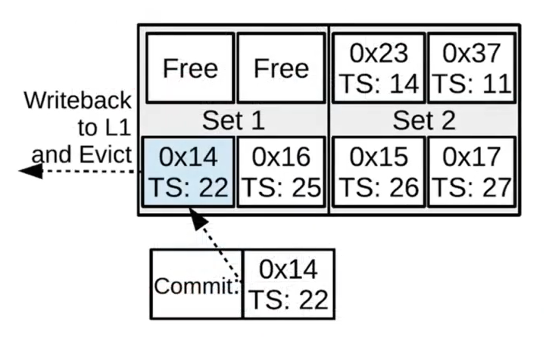
Free-slotting
Avoids resource starvation

Slide 20
LeapFrogging
MSHR:
stores miss status
enables parallel misses
Non-inclusive/
non-exclusive cache
DRAM
MSHR
LLC
MSHR
L2
MSHR
L1D
GM
CPU

Slide 21
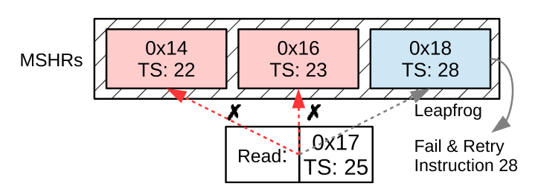
LeapFrogging
Older instruction can kick out MSHR entry of newer instruction

Slide 22
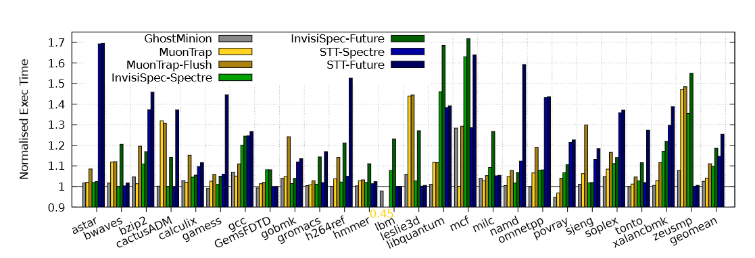
Performance evaluation: SPEC 2006
GhostMinion 2.5% slowdown compared to 4% slowdown for MuonTrap

Slide 23
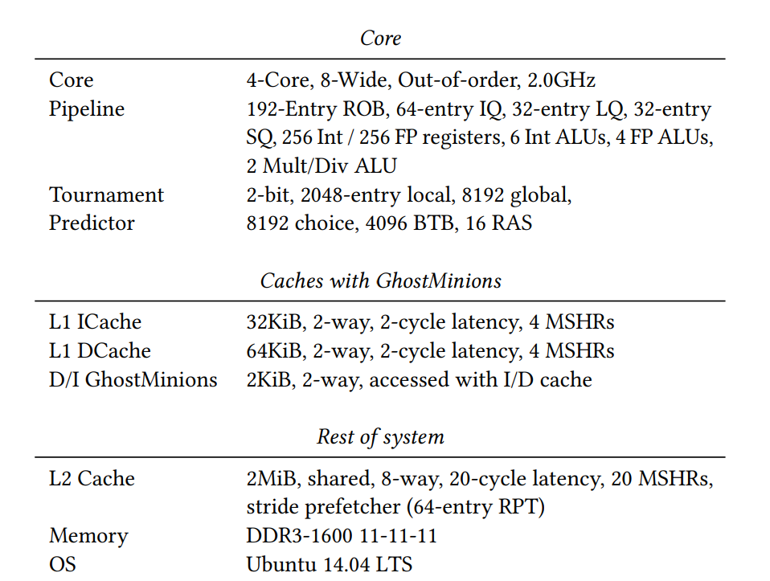

Evaluation setup?
Modern processors:
Large ROB
Large Load-Store queue
Aggressive hardware prefetchers
VIPT cache
Multi-level TLBs
Multiple page table walkers
ROB size: 600 entries

Slide 24
What is the big deal? The problem(s)
Evaluation setup does not model modern processors with heterogeneous workloads
Larger ROB ☺, higher branch resolution latency ☹
On-commit prefetching only ☹, prefetch timeliness ☹ ☹
TLBs, PTWs, supporting structures, queues should be modified while handling speculative translations ☹
Notes:
Hypothesis:
Thrashing of filter cache
High performance overhead

Slide 25
The 1st step
To implement GhostMinion (GM) and evaluate/analyse the performance overhead with modern cpu parameters

Slide 26
Implementation details
Out-of-order CPU
Page table walker
3k lines of code
1k lines of code
Cache
DRAM
controller
5k lines of code
1k lines of code
TLB
Instruction cache
Data
cache

Slide 27
Implementation challenges
Goal: To integrate another cache level(GM)
Complexities:
Out-of-order CPU
Cache
Out-of-order functionality
Dependency resolution
Load-store queue with data forwarding
Virtually indexed physically tagged (VIPT) cache

Slide 28
Implementation challenges: VIPT cache
Complexities:
Need to make sure MSHR and RQ are consistent
While filling, need to take of appropriate addressing
DRAM
LLC
Page table walker
MSHR
L2
RQ
MSHR
L1
GM
TLB
RQ
CPU

Slide 29
Ongoing work
To complete the implementation of GhostMinion
LeapFrogging
Extend features to TLBs
Idea: separate speculative cache hierarchy

